Slide 1
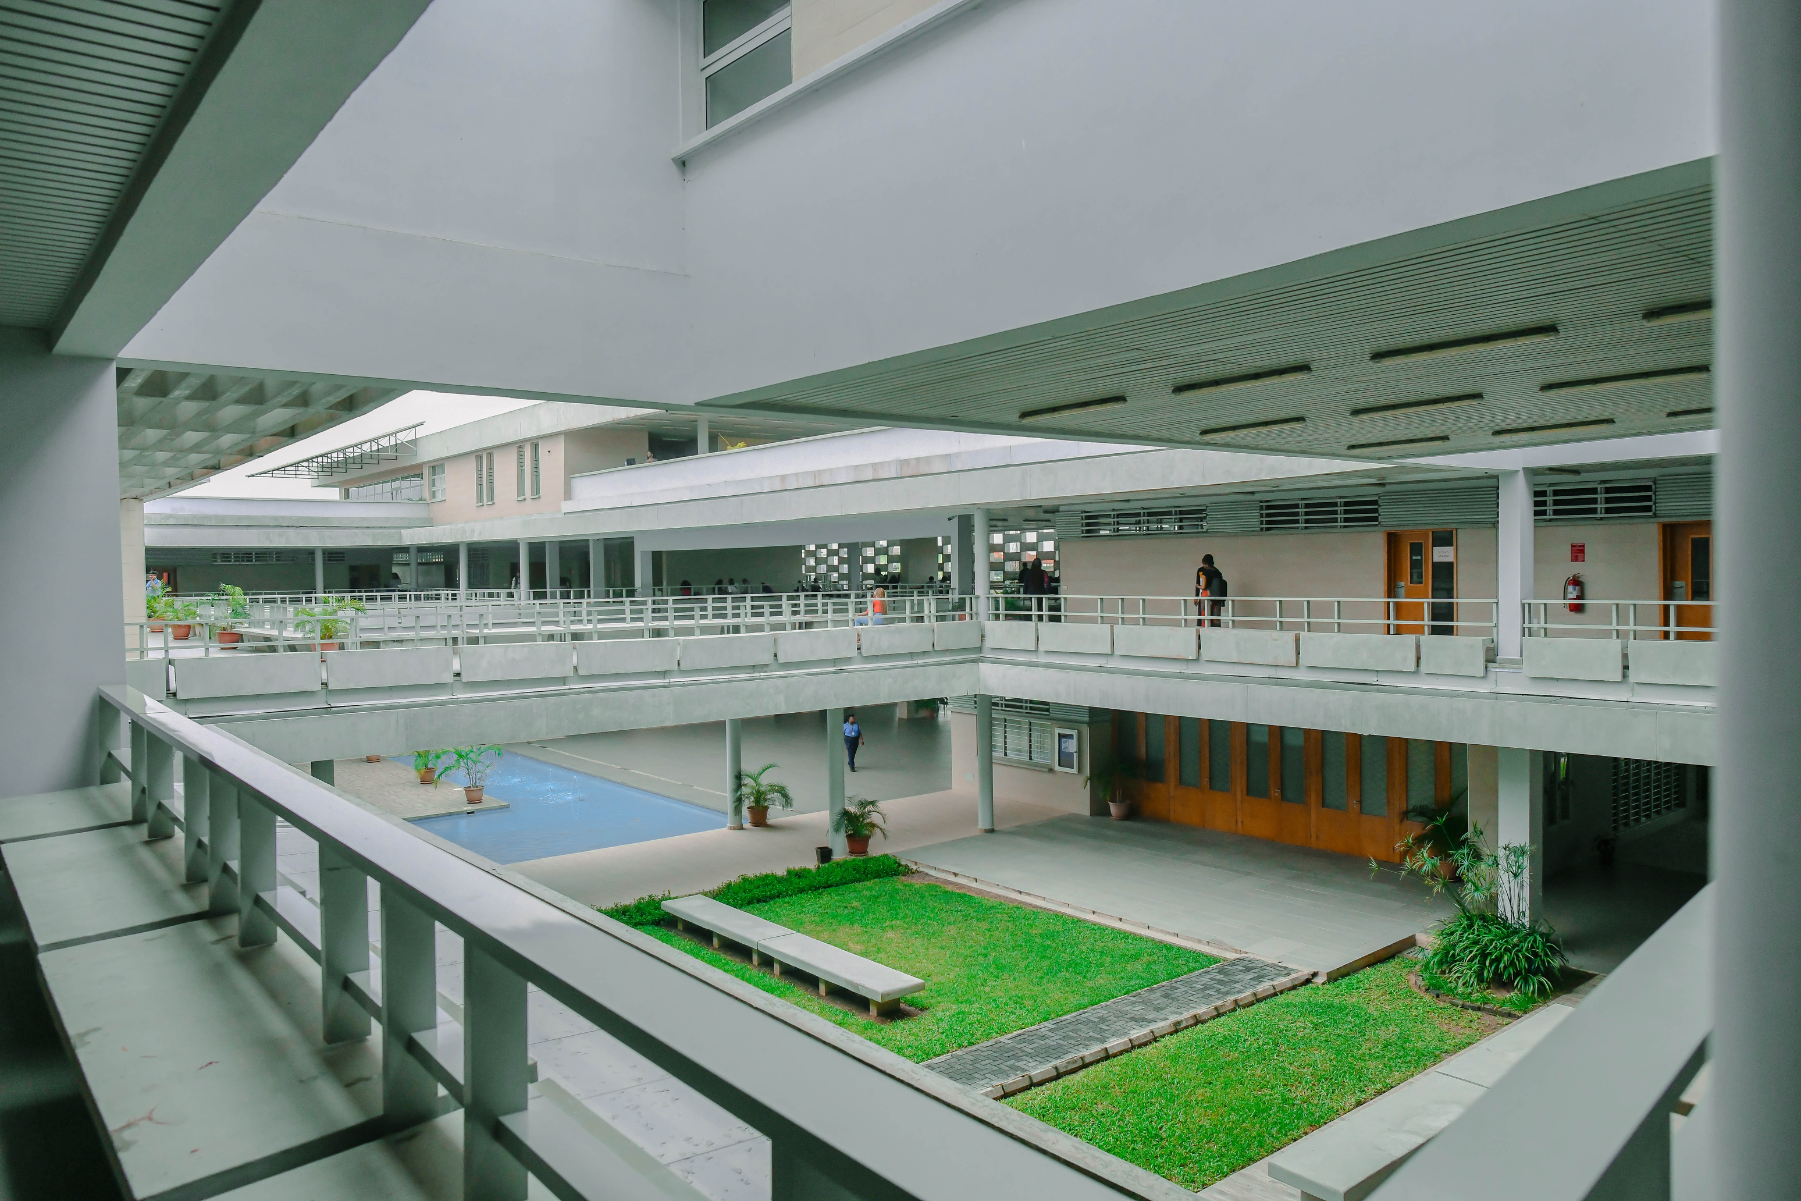

Vectors, Tuples and Slices
CSC 101 Practical · Week 8
2026/2027 Session
Pan-Atlantic University

Slide 2
Today's Practical
Part 1
Vectors
Arrays that grow. Create them, reach inside three ways, update and combine them. Practices 1 to 6.
Part 2
Tuples
Mixed types in one bundle: access, mutate, pass and unpack. Practices 7 to 10.
Part 3
Slices
A window into someone else's data. Practices 11 and 12.
Projects
Two class projects
A civil-service level checker and a hiring problem from EY Nigeria.

Slide 3

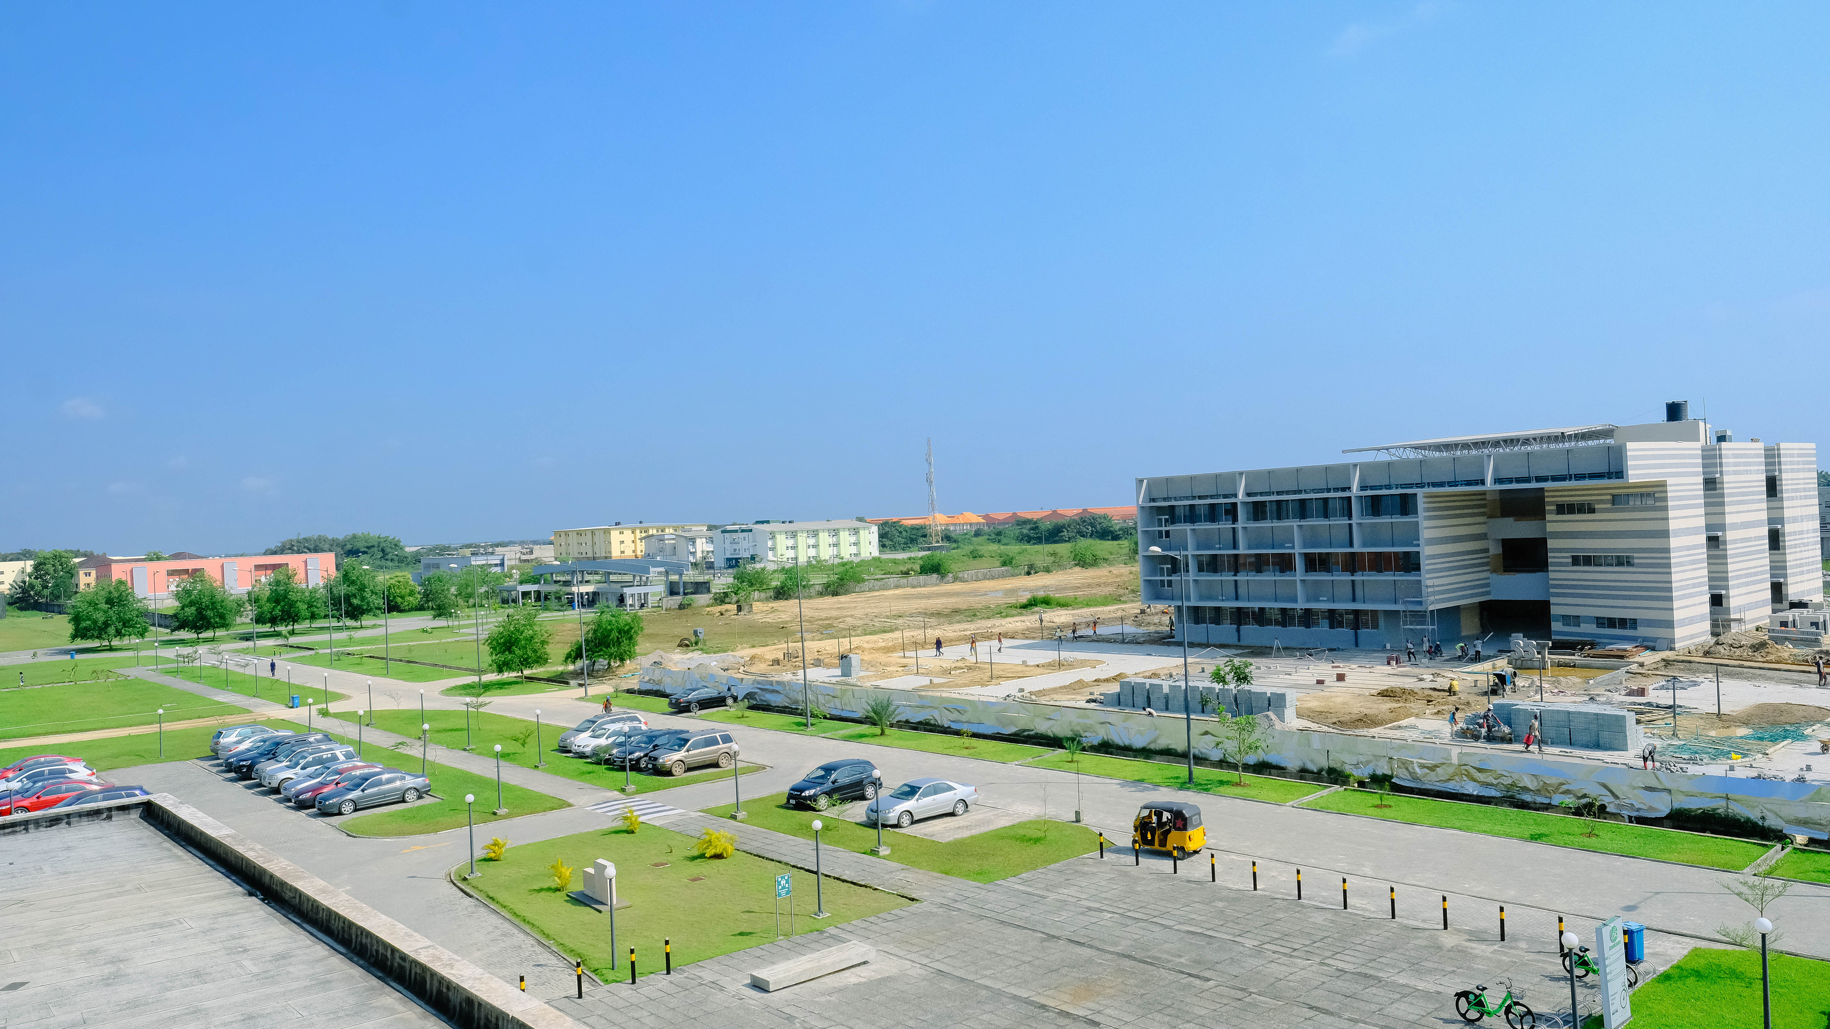
PART 1 OF 3
Vectors
The array that grows: created, read, updated and combined at runtime.

Slide 4
What is a Vector?
An array that grows
A vector stores values like an array, but its size can increase dynamically at runtime. It comes from the standard library and holds values of one data type.
Length vs capacity
Length is how many elements are in the vector right now. Capacity is how much space has been allocated for it on the heap.
Two ways to make one
Vec::new() starts empty; the vec! macro starts loaded. Practice 1 shows both.

Slide 5
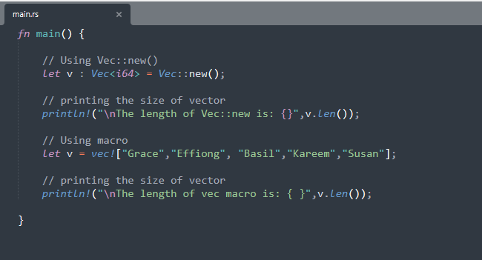
Practice 1: Creating Vectors
Both creation styles side by side: the method and the macro.
1
Empty, then filled later
let v: Vec<i64> = Vec::new();
Length 0 for now.
2
Or loaded on arrival
let v = vec!["Grace", "Effiong", ...];
3
len() still counts
v.len()

Slide 6
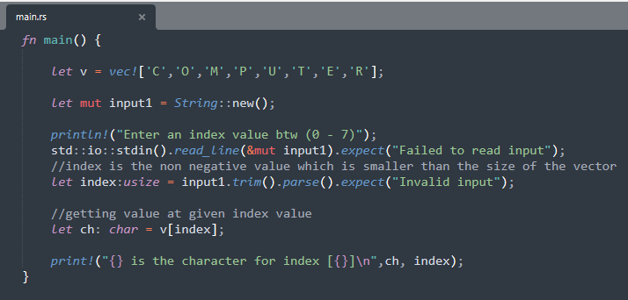
Practice 2: The Subscript Operator
Three ways to reach inside a vector: subscript, get() and iteration. First, the subscript.
1
Indexing, like arrays
let ch: char = v[index];
2
But guarded first
The code checks the index is non-negative and smaller than the size before using it.
3
Why the guard matters
An index past the end does not return nothing. It crashes the program.

Slide 7
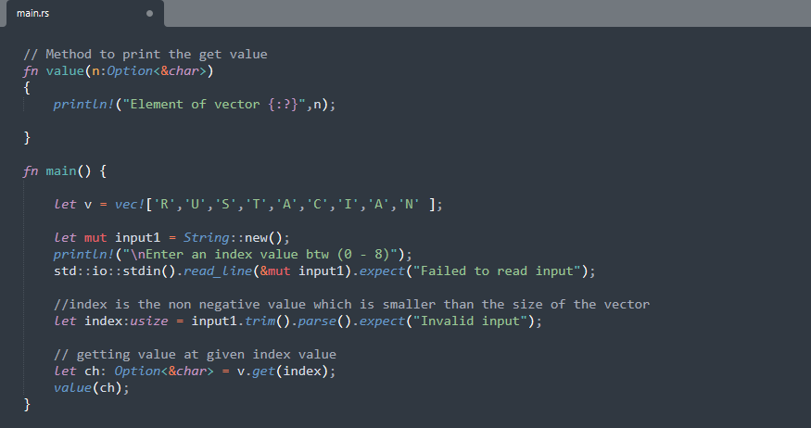
Practice 3: The get() Method
The safer second way: get() never panics, it answers with an Option.
1
Ask politely instead
let ch = v.get(index);
2
The answer comes wrapped
Some('U') if the index exists, None if it does not. No crash either way.
3
Print it with {:?}
Option values are debug-printed. The full Option story comes later.

Slide 8
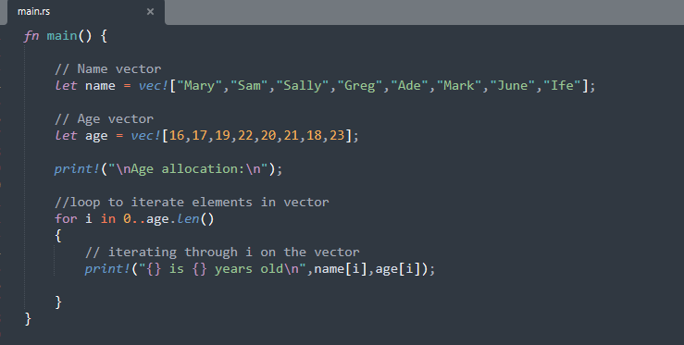
Practice 4: Iterating
The third way in: a for loop, exactly like arrays last week.
1
Two vectors, side by side
name and age
2
One loop reads both
for i in 0..age.len()
3
Index pairs them up
println!("{} is {} years old", name[i], age[i]);
Tip: Count both vectors before running. If one is shorter than the loop, the program panics with index out of bounds.

Slide 9
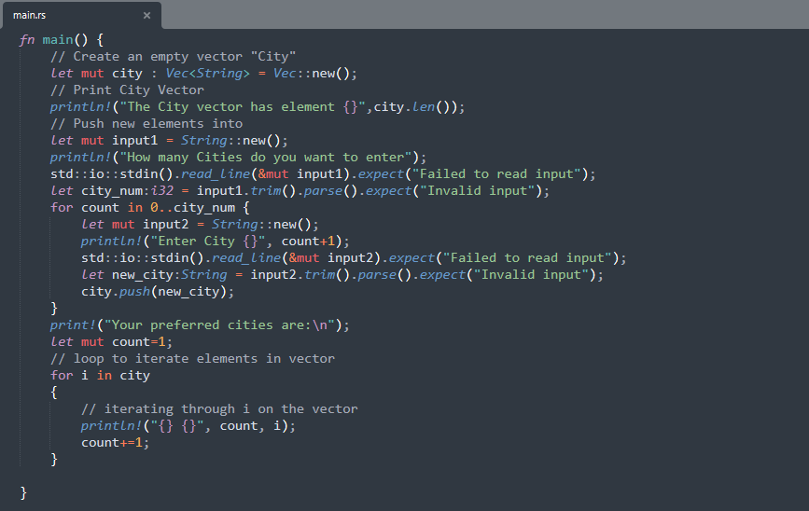
Practice 5: Updating a Vector
A program that builds its data while it runs: your preferred cities, pushed in one by one.
1
Start empty
let mut city: Vec<String> = Vec::new();
2
Grow it from input
city.push(new_city);
3
This is the superpower
An array could never do this. The vector grows one city at a time, at runtime.

Slide 10
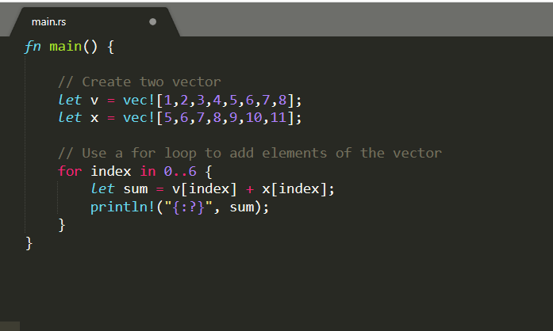
Practice 6: Adding Two Vectors
Element by element addition, the way Practice 4 paired names with ages.
1
Two vectors of numbers
let v = vec![1,2,3,4,5,6,7,8];
2
One loop, pairwise sums
let sum = v[index] + x[index];
3
The index does the pairing
Element 0 with element 0, element 1 with element 1, and so on.

Slide 11
PART 2 OF 3
Tuples
One bundle, many types. Fixed length, unpacked however you need.

Slide 12
What is a Tuple?
A compound type
A scalar type holds one kind of value. A tuple holds several values at once, and they can be of different types.
Fixed length
Once declared, a tuple cannot grow or shrink. Its index starts at 0.
Printing needs {:?}
println! with plain {} cannot display a tuple. Compound types are printed with the {:?} syntax.

Slide 13
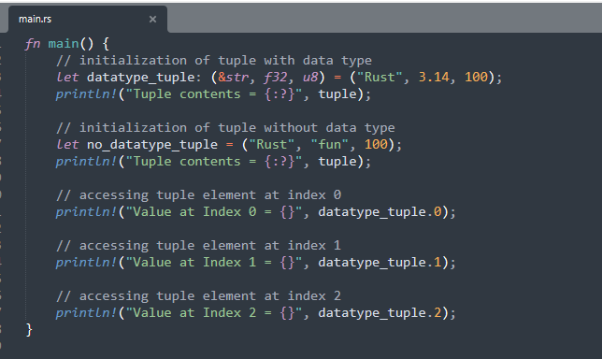
Practice 7: Making and Reading Tuples
Three different types in one bundle, read back with dot-number access.
1
With types spelled out
let t: (&str, f32, u8) = ("Rust", 3.14, 100);
2
Or inferred
let t = ("Rust", "fun", 100);
3
Reach in with a dot
t.0, t.1, t.2

Slide 14
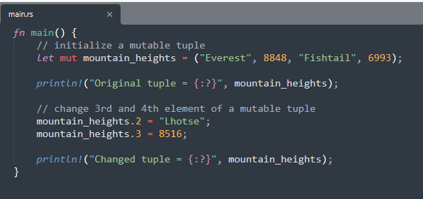
Practice 8: Mutable Tuples
Tuples are immutable by default, exactly like variables. mut unlocks them.
1
mut works here too
let mut mountain_heights = ...;
2
Change elements in place
mountain_heights.2 = "Lhotse";
3
Length stays fixed
You can change what is inside, never how many things are inside.

Slide 15
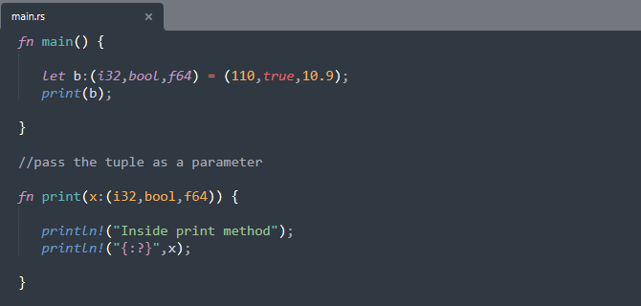
Practice 9: Passing a Tuple
A tuple travels into a function as a single argument.
1
One parameter, whole bundle
fn print(x: (i32, bool, f64)) {
2
Passed by value
print(b);
3
The type must match exactly
Same types, same order, same length.

Slide 16
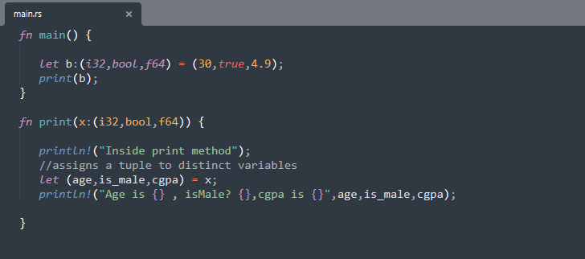
Practice 10: Destructuring
Instead of x.0 and x.1 everywhere, unpack the tuple into named variables.
1
Break the bundle open
let (age, is_male, cgpa) = x;
2
Three names, one line
Each variable takes the matching position from the tuple.
3
Then use them plainly
println!("Age is {}, ...", age, ...);

Slide 17
PART 3 OF 3
Slices
Borrowed windows into arrays and vectors. Small topic, big idea.

Slide 18
What is a Slice?
A pointer to a block of memory
A slice does not own data. It points into a portion of data stored in contiguous memory: part of an array, a vector or a string.
Sized at runtime
The size of a slice is determined when the program runs, using index numbers to mark the portion.
Borrowing, by name
Slices are passed to functions by reference. Rust calls that borrowing, and Week 10 is named after it.

Slide 19
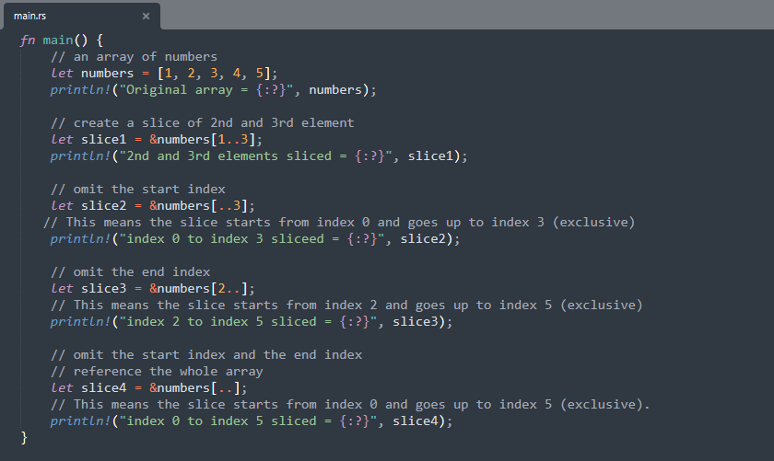
Practice 11: Slicing an Array
Five numbers in an array, viewed through four different windows.
1
The & makes the window
let slice1 = &numbers[1..3];
2
Start included, end excluded
[1..3] is elements 1 and 2. The range rule from Week 4, again.
3
Both ends are optional
[..3], [1..], [..]

Slide 20
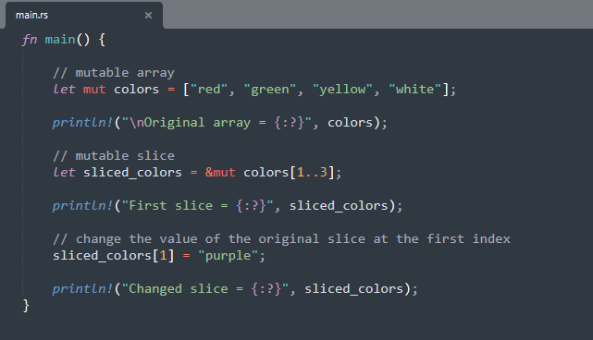
Practice 12: Mutable Slices
A slice can change the data it looks at, if you borrow with &mut.
1
Borrow it mutably
let sliced_colors = &mut colors[1..3];
2
Write through the window
sliced_colors[1] = "purple";
3
The original changes
The slice is not a copy. Editing it edits the vector underneath.

Slide 21
CLASS PROJECTS
Projects I and II
A federal service level checker, and EY Nigeria's hiring problem.

Slide 22
Project I: The APS Level Checker
You have joined a team building a Public Service APS level checker for the Federal Government of Nigeria. Using vectors, validate a staff level from this table. Example: an Associate Lawyer with 5 to 8 years of experience holds position APS 5-8.
Public Servant
Office Admin
Academic
Lawyer
Teacher
APS 1-2
Intern
-
Paralegal
Placement
APS 3-5
Administrator
Research Assistant
Junior Associate
Classroom Teacher
APS 5-8
Senior Administrator
PhD Candidate
Associate
Senior Teacher
EL1 8-10
Office Manager
Post-Doc Researcher
Senior Associate 1-2
Leading Teacher
EL2 10-13
Director
Senior Lecturer
Senior Associate 3-4
Deputy Principal
SES
CEO
Dean
Partner
Principal

Slide 23
Project II: The EY Interview
Ernst & Young (EY) Global Limited is a multinational professional services network headquartered in London, with branch offices all around the world. EY Nigeria recently launched a project and is scouting for developers with the highest years of experience. The CEO of EY Nigeria has contacted you: develop a Rust program that finds the person with the highest years of programming experience during the job interview, using any Rust compound data type.
Hints
A vector of tuples fits this well: (name, years). Walk it with a loop, keep the highest seen so far.
Compound data type means vector, tuple or slice. Your pick, your defence.

Slide 24


Questions?
Homework: Both projects, pushed to week-8.
www.pau.edu.ng
pau_Nigeria
Pan-Atlantic University

